Slide 1
Reading an Image: Elements & Principles of Composition
Line
Color
Shape/Form
Space
Texture
Balance
Contrast
Movement
Emphasis
Pattern
Proportion
Unity

Slide 2
Elements of Composition
Line
Color
Shape/Form
Space
Texture
Notes:
most basic building block of design
Line can be used to create more complex shapes
lead your eye from one area in the composition to another
horizontal – passive, submissive
vertical – dominant, active
diagonal – movement, motion

Slide 3
Elements of Composition
Line
Color
Hue
Value
Intensity
Shape/Form
Space
Texture
Primary
Secondary
Color
Wheel
Warm
Cool
Value
Intensity/Saturation
Notes:
Color talked about in 3 ways…
Hue – what is is? Red, green, yellow?
Value – how light or dark
Intensity (saturation) – how bright or dull
differentiates and defines lines, shapes, forms, and space.
often cultural symbolism or references
what can red symbolize? What is the context?
Not just analyzing the colors individually but what combinations exist

Slide 4
Elements of Composition
Line
Color
Shape/Form
Space
Texture
Notes:
Created when lines are combined and closed
Shape – 2D
Form – 3D
Geometric – circle, square, pyramid
Organic – found in nature

Slide 5
Elements of Composition
Line
Color
Shape/Form
Space
Texture
Notes:
is the area between and around objects.
Positive and negative space
Space can also refer to the feeling of depth. Real space is three-dimensional; in visual art when we can create the feeling or illusion of depth we call it space.
Increasing or decreasing the amount of space around an object affects the way we view that object.
is the central figure very large or very small in relation to the frame?
What does the difference mean?

Slide 6
Elements of Composition
Line
Color
Shape/Form
Space
Texture
Notes:
the surface quality that can be seen and felt.
Textures can be rough or smooth, soft or hard.
Textures are often implied

Slide 7
Principles of Composition
Balance
Contrast
Movement
Emphasis
Pattern
Proportion
Unity
Notes:
distribution of the visual weight of objects, colors, texture, and space.
Symmetrical or asymmetrical composition
created in a work of art when textures, colors, forms, or shapes are combined harmoniously.
Lack of balance can create anxiety or discomfort.

Slide 8
Principles of Composition
Balance
Contrast
Movement
Emphasis
Pattern
Proportion
Unity
Notes:
color, form, texture use to differentiate from one object to another
What is the level of contrast? What stands out the most?

Slide 9
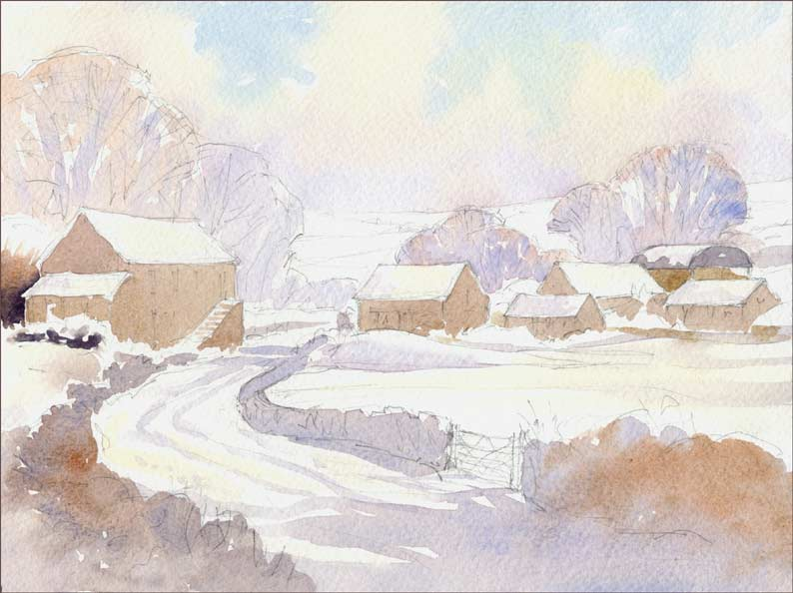
Principles of Composition
Balance
Contrast
Movement
Emphasis
Pattern
Proportion
Unity
Notes:
the way a viewer's eye is directed to move through a composition, often to areas of emphasis.
Line, shape, color
“Z movement” common in advertising – traditional
“U movement” – new to advertising, younger generation – matches the way the look at websites because of navigation structure
How is your eye led through the image?
what are you supposed to see first? Last?
Where does your eye stop?

Slide 10
Principles of Composition
Balance
Contrast
Movement
Emphasis
Pattern
Proportion
Unity
Notes:
contrasts colors, textures, or shapes to direct your viewing towards a particular part of the image.
Focal point
Rule of thirds
Used for centuries by artists
Visually more interesting when focal point is not in the dead center
Rules of thirds is sometimes broken to make the subject appear dull, boring, mundane.

Slide 11
Principles of Composition
Balance
Contrast
Movement
Emphasis
Pattern
Proportion
Unity
Notes:
repetition of a shape, form, or texture across a work of art.
There can be repetition of shape and form that is not always obvious at first glance.

Slide 12
Principles of Composition
Balance
Contrast
Movement
Emphasis
Pattern
Proportion
Unity
Notes:
size of elements or objects in relation to one another
When drawing the human figure, proportion can refer to the size of the head compared to the rest of the body.
Disproportion can give an uneasy, unnatural feeling

Slide 13
Principles of Composition
Balance
Contrast
Movement
Emphasis
Pattern
Proportion
Unity
Balance
Contrast
Movement
UNITY
Emphasis
Proportion
Pattern
Notes:
principles of composition are present in harmony
When unity exists there is a feeling of completeness
No unity can cause feelings of tension, anxiety, uneasiness.

Slide 14
Reflection
What is the tone or mood of the image?
What symbolism or cultural references are being use?
What is the message?
Who is the intended audience.
Notes:
Interpret meaning from formal elements.
What is the message? What ideas are being presented or represented?
How is the intended audience? How could the message change with a difference audience?

Slide 15
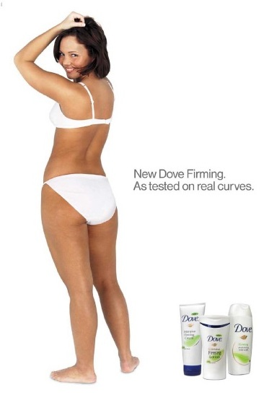
Notes:
2 ads featuring full-body portraits of women, but very different messages, audiences, and techniques

Slide 16
Notes:
What is the tone or mood of the image?
What symbolism or cultural references are being use?
Interpret meaning from formal elements.
Line – woman’s body makes a strong vertical line = strength, confidence
Color – bright white = clean, fresh, pure, simple
Shape – organic shape of the body = natural
Space – lots of open white (negative) space = clean, simple, uncluttered
- woman fills frame vertically = reinforces ideas of strength, confidence
Texture – smooth, soft
Balance, Proportion and Unity are in harmony
Contrast – skin stands out against clothing and background
Movement - Eye moves up the body and stops at the face
Emphasis – her face - She is looking directly at the viewer.
Even though she is not wearing much clothing the white underwear still make her look whole-some.
Her body has curves, not the “model” figure.
What is the message/idea?
Clean, fresh, natural
Who is the intended audience?
Average, everyday women

Slide 17
Notes:
What is the tone or mood of the image?
What symbolism or cultural references are being use?
Interpret meaning from formal elements.
Line – woman’s body makes a horizontal line = submission
- many diagonals in body suggestion motion, action
Color – pink, yellow, blue, high intensity (saturation) = hyper-real, unnatural
Shape – combination of organic (body) and geometric (disco ball, chain, martini glass)
Space – woman’s body fills the frame, not a lot of open space
Texture – smooth, shiny, plastic = hyper-real, unnatural
Balance – the image is balanced but the body position of the woman is not
Contrast – woman stands out against background, clothing stands out against skin
Movement – eyes move along lines of body from face to feet
Emphasis – shape of neckline, color of clothing, chain, and lines in leg all lead to middle of her body
Pattern – disco ball reflected on her skin, shape mimicked in chain
Proportion – disco ball out of proportion with woman
Unity – while the image is not completely un-unified, because of balance and proportion there is a feeling of tension (sexual)
Woman’s head thrown back, eyes closed, mouth open as if she is in the throws of ecstasy. Not looking at the viewer.
Stylized to look artificial, Barbie-like, object of male desire.
What is the message/idea?
SEX, this woman likes this product and if you use it you can get women like her!
Who is the intended audience?
Men (21-40)

Slide 19
???
Krista Siniscarco
ksinisca@hamilton.edu
Instructional Technologist
Hamilton College

